Slide 1



Integrating Project
Covid-19 in Brazil

Slide 2

Study Purpose
'There is no longer a risk group for Covid-19’
G1
Develop a predictive model that helps to define the patient’s risk, given their characteristics
Notes:
https://g1.globo.com/bemestar/coronavirus/noticia/2021/04/17/nao-existe-mais-grupo-de-risco-para-a-covid-19-entenda-por-que-cientistas-defendem-alerta-amplo-sobretudo-para-os-mais-jovens.ghtml

Slide 3


The data...
153
Features
123
Features meaningless They were removed
811.229
Observations
Selected Variables
Model:
Random Forest via feature_importance
41
Were applied Dummies
Demográfico
Condições de saúde
Comorbidades
Com 59 features:
75% accuracy
Before
435.028
Observations
After
376.201
Observations
13
Selected for the final model
Com 13 features:
73% accuracy

Slide 4









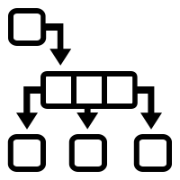

Data preparation
Treatment base
Loading
Filters
- 20 Biggest Cities
- Inpatients only
- Cured/Deaths by Covid
Ouliers
(By Describe)
Removal of Columns
(with only answer, poorly filled in and withoutlogical explanation)
Withdrawal duplicates
Base prior to vaccine
Base during vaccination
Pre-Processing
Re-categorization
Of the variables
Application
Dummy
Base Split
(test = 0.3)
Balancing
(SMOTE)
Random Forest
(By feature importance)
Adjustment of model

Slide 5




IMPLEMENTATION OF ML
Base Split
(test = 0.3)
Balancing
(SMOTE)
Adjustment Simulation
for the Accuracy
Cross-Validation (Kfolds=10)
Model with
greater accuracy
Fit of the best model with the best test
24
Classification
models

Slide 6

MODEL SELECTION
Modeling fot the 20 largest cities
Before Vaccination
During Vaccination
Model
Acc
Model
Acc
Goiânia | Bagging Classifier | 81,1% | Random Forest Classifier | 79,6%
Belém | CatBoosting Classifier | 78,7% | Gradiente Boosting Classifier | 85,4%
Guarulhos | Bagging Classifier | 82,9% | Bagging Classifier | 81,0%
Campinas | Bagging Classifier | 82,8% | Random Forest Classifier | 84,5%
São Luís | Xgboost | 77,6% | Xgboost | 84,3%
São Gonçalo | Gradiente Boosting Classifier | 74% | Light Gradiente Boosting Classifier | 83,3%
Maceió | Random Forest Classifier | 81,9% | Bagging Classifier | 83,6%
Duque de Caxias | Xgboost | 79% | Xgboost | 88,4%
Natal | Bagging Classifier | 83,6% | Random Forest Classifier | 83,3%
Campo Grande | Xgboost | 85,8% | CatBoosting Classifier | 84,5%
São Paulo | Bagging Classifier | 81,1% | CatBoosting Classifier | 72,4%
Rio de Janeiro | CatBoosting Classifier | 72,5% | CatBoosting Classifier | 72,8%
Brasília | Bagging Classifier | 85,1% | Bagging Classifier | 87,0%
Salvador | Random Forest Classifier | 82% | Bagging Classifier | 85,3%
Fortaleza | Bagging Classifier | 79% | CatBoosting Classifier | 84%
Belo Horizonte | Bagging Classifier | 82,2% | Bagging Classifier | 81,2%
Manaus | Random Forest Classifier | 78,7% | Random Forest Classifier | 79,3%
Curitiba | Bagging Classifier | 83,4% | Bagging Classifier | 81,7%
Recife | Bagging Classifier | 75,2% | Random Forest Classifier | 78,7%
Porto Alegre | Random Forest | 82,2% | CatBoosting Classifier | 79,6%

Slide 7
ADJUSTMENT OF SELECTED MODELS
Modeling for the 20 largest cities
Before Vaccination
During Vaccination
Model
Acc
Model
Acc
São Paulo | Bagging Classifier | 67,5% | CatBoosting Classifier | 78,8%
Rio de Janeiro | CatBoosting Classifier | 72,5% | CatBoosting Classifier | 73,4%
Brasília | Bagging Classifier | 74,8% | Bagging Classifier | 77,9%
Salvador | Random Forest Classifier | 73,6% | Bagging Classifier | 78%
Fortaleza | Bagging Classifier | 70,3% | CatBoosting Classifier | 83,3%
Belo Horizonte | Bagging Classifier | 64,9% | Bagging Classifier | 66,4%
Manaus | Random Forest Classifier | 73,5% | Random Forest Classifier | 72,5%
Curitiba | Bagging Classifier | 69,2% | Bagging Classifier | 72,6%
Recife | Bagging Classifier | 63,9% | Random Forest Classifier | 70,1%
Porto Alegre | Random Forest | 73,4% | CatBoosting Classifier | 80,3%
Goiânia | Bagging Classifier | 71,4% | Random Forest Classifier | 70,4%
Belém | CatBoosting Classifier | 77,9 | Gradiente Boosting Classifier | 85,7%
Guarulhos | Bagging Classifier | 69,1% | Bagging Classifier | 70,4%
Campinas | Bagging Classifier | 70,0% | Random Forest Classifier | 82,0%
São Luís | Xgboost | 70,7% | Xgboost | 79,7%
São Gonçalo | Gradiente Boosting Classifier | 72,3% | Light Gradiente Boosting Classifier | 79,1%
Maceió | Random Forest Classifier | 75,9% | Bagging Classifier | 74%
Duque de Caxias | Xgboost | 74,4% | Xgboost | 76,7%
Natal | Bagging Classifier | 75,8% | Random Forest Classifier | 79,5%
Campo Grande | Xgboost | 79,8% | CatBoosting Classifier | 84%

Slide 8


Simulating by City
Simulated result
 | Before | During
São Paulo/SP | Óbito | Cura
Rio de Janeiro/RJ | Cura | Óbito
Brasília/DF | Óbito | Cura
Salvador/BA | Óbito | Óbito
Fortaleza/CE | Óbito | Óbito
Belo Horizonte/MG | Cura | Cura
Manaus/AM | Óbito | Óbito
Curitiba/PR | Óbito | Óbito
Recife/PE | Cura | Óbito
Porto Alegre/RS | Cura | Óbito
Profile
Men
43 years
Other race (Other than Brown)
With PCR result as undetectable
Admitted to the UTI
With symptoms of fever
With cough symptoms
With cough dyspnea
With saturation > 95%
Introducing risk factors
Using invasive mechanical ventilation
No respiratory distress

Slide 9
Simulating by City
Simulated result
 | Before | During
Goiânia/GO | Cura | Óbito
Belém/PA | Óbito | Óbito
Guarulhos/SP | Cura | Cura
Campinas/SP | Cura | Cura
São Luis/MA | Óbito | Óbito
São Gonçalo/RJ | Óbito | Óbito
Maceió/AL | Óbito | Óbito
Duque de Caxias/RJ | Cura | Cura
Natal/RN | Óbito | Óbito
Campo Grande/MS | Cura | Óbito
Profile
Men
43 years
Other race (Other than Brown)
With PCR result as undetectable
Admitted to the UTI
With symptoms of fever
With cough symptoms
With cough dyspnea
With saturation > 95%
Introducing risk factors
Using invasive mechanical ventilation
No respiratory distress

Slide 10

The selected features
Feature discrimination power

Slide 11

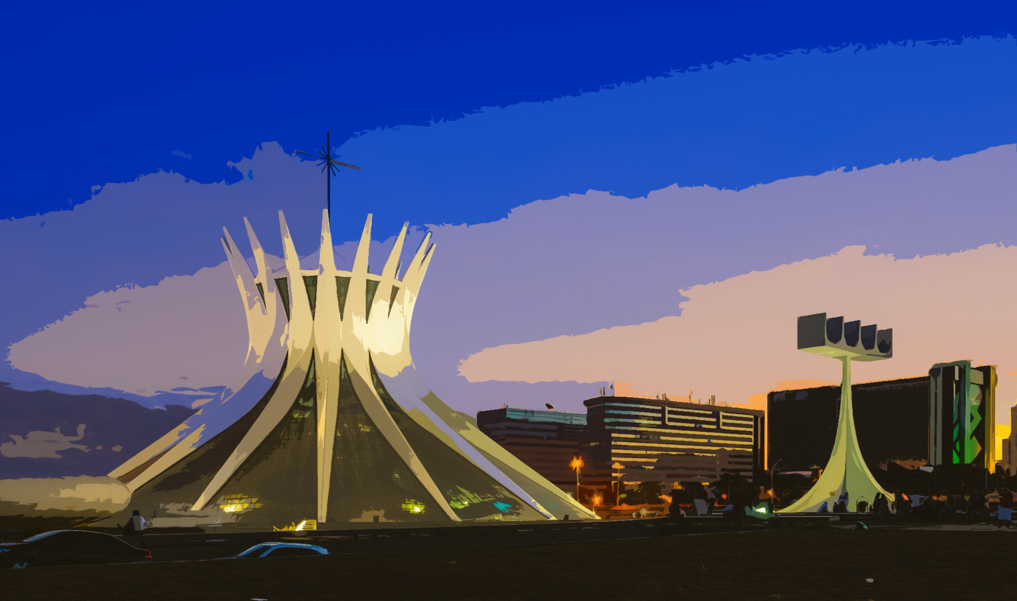
Detailed Analysis - Brasília
Feature discrimination power
Before Vaccines
During Vaccination

Slide 12
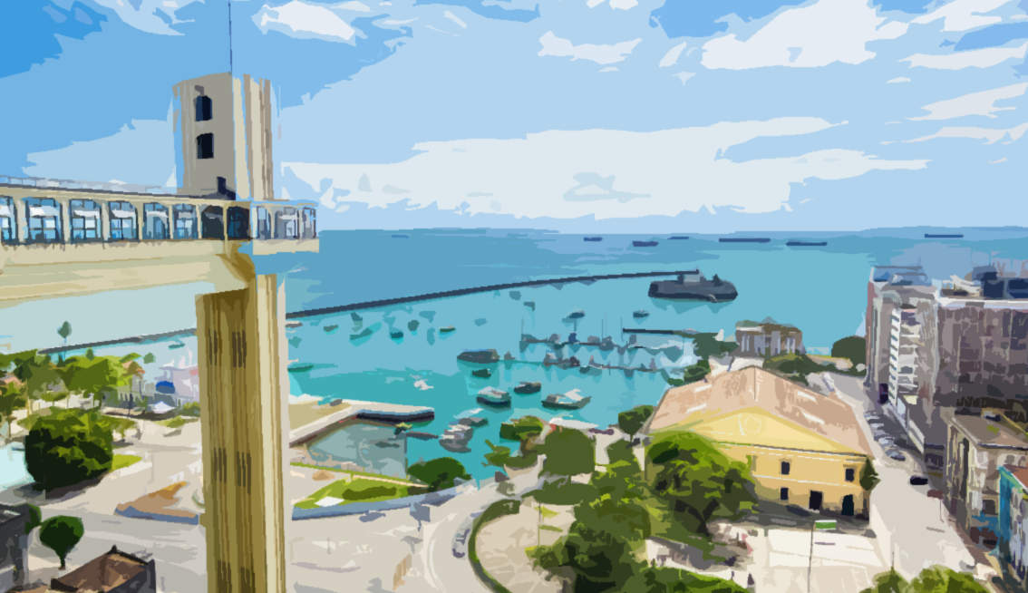

Detailed Analysis - Salvador
Feature discrimination power
Before Vaccines
During Vaccination

Slide 13

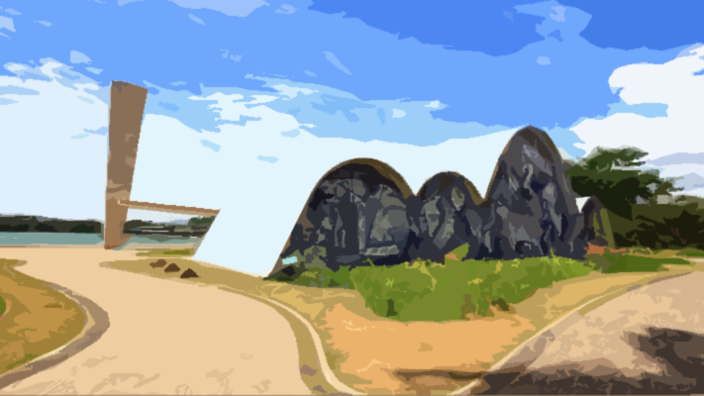
Detailed Analysis – Belo Horizonte
Feature discrimination power
Before Vaccines
During Vaccination

Slide 14
Integrating Project
Covid-19 in Brazil

